Slide 1
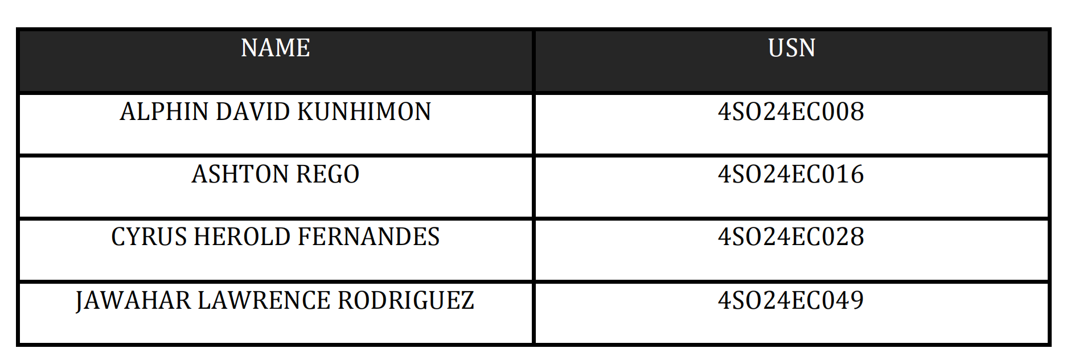
DEPARTMENT OF ELECTRONICS & COMMUNICATION ENGINEERING ST JOSEPH ENGINEERING COLLEGE VAMANJOOR MANGALURU-575028 Course Title: Digital Design using HDL Course Code: 22ECE42 Semester: Fourth Semester PBL Secondary Research Report FPGA Based-Advanced Encryption Standard (AES)

Slide 2
What is AES?
Plaintext to statematrix

Slide 3
Core models
Subbytes/inv
Shiftorws/inv

Slide 4
Gf multiplier
In GF arithmetic:
numbers are treated like polynomials
addition is XOR
overflow is reduced using a special polynomial
So multiplication behaves differently.
----------------------------------------
Flow:
Input a
↓
Check sel
↓
00 → multiply by 1
01 → multiply by 2
10 → multiply by 3
↓
Output result
--------------------------------------------------
What if the msb is 1?
AES uses a fixed polunomial reduction modulo which is:
x^8 + x^4 + x^3 + x + 1
So when overflow happens, it is shifted and xor'd with 8'h1b.

Slide 5
Gf mixcoloumns single
In this operation, a single coloumn is taken and the follow equations are performed to get a new coloumn
assign b0 = mul2(a0) ^ mul3(a1) ^ a2 ^ a3;
assign b1 = a0 ^ mul2(a1) ^ mul3(a2) ^ a3;
assign b2 = a0 ^ a1 ^ mul2(a2) ^ mul3(a3);
assign b3 = mul3(a0) ^ a1 ^ a2 ^ mul2(a3);

Slide 6
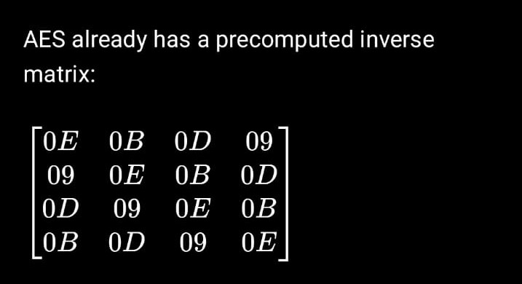
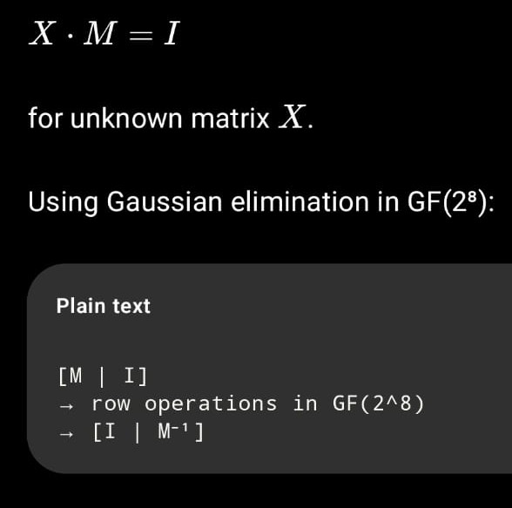
mixcoloumn/inv

Slide 7
Round Key Expansion
So in the beginning a master key is exored with the plain text, then the scrambled text is produced. All in 128 bits for round 0.
Then for all the remaining rounds, round key is derived from the master key.
In round 1-9 there is subybtes, shift rows, mix columns, add round key.
In round 1-9, each round produces a round key that is exored with the curreent state.
Then in round 10 again there is all this except mix columns. The output of the last exor is my cipher text.
The formula is: state(out)= state(in)^roundkey
Formula for key expansion:
Rotword([b0, B1, B2, B3]) = [B1, B2, B3, B0]
Temp = rotword(w3) ^ rcon[round]

Slide 8
ROUND KEY EXPANSION
How the Code Works
This Verilog code implements a hardware-based Key Expansion module, which generates the next 128-bit round key from a previous key.
Inputs and Outputs: The module takes a 128-bit key_in and a 4-bit round number to produce a 128-bit key_out.
Word Splitting: The 128-bit input is split into four 32-bit words (w_0, w_1, w_2, w_3) using assign statements.
RotWord Function: This cyclically rotates the 32-bit word w_3 to the left by 8 bits (1 byte) using the concatenation operator {w[23:0], w[31:24]}.
Rcon Function: A lookup table (case statement) returns a specific 8-bit hex value for each round (e.g., 8'h01 for round 1, 8'h02 for round 2). This eliminates symmetry in the keys.
Transformation Flow:
reg [31:0] temp; A temporary register used to hold intermediate calculations for the transformation.
temp = rot_word(w3) rotates the last word.
temp = temp ^ {rcon_val, 24'h0} performs a bitwise XOR between the rotated word and the round constant.
Key Generation: The new words are created by XORing the previous words with the transformed temporary word in a "chain" fashion:
key_out[127:96] = w0 ^ temp.
key_out[95:64] = w1 ^ key_out[127:96].
key_out[63:32] = w2 ^ key_out[95:64].
key_out[31:0] = w3 ^ key_out[63:32]

Slide 9
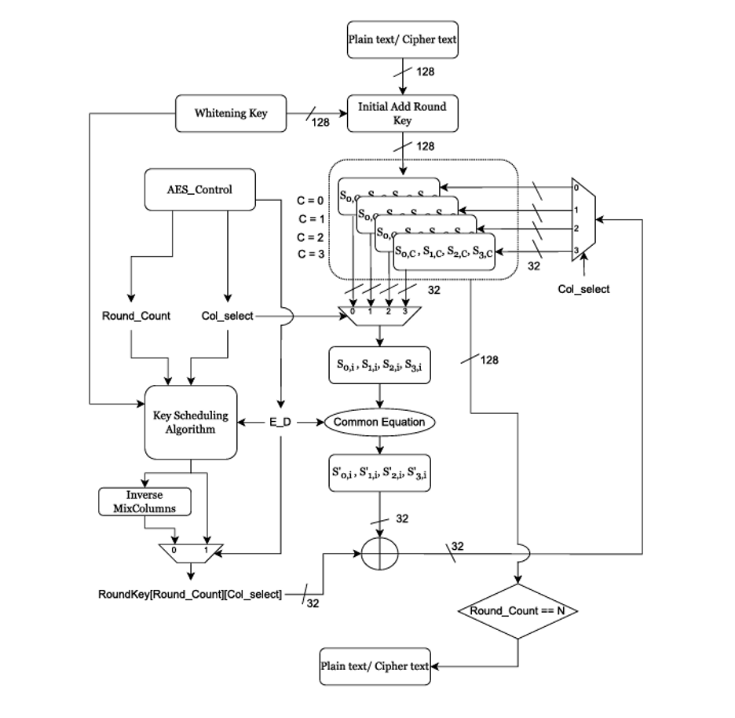
Architecture
1. Control & Scheduling
AES Control: Manages the round progression and column selection.
Key Scheduling: Expands the initial 128-bit key into unique round keys for every column and round.
Inverse MixColumns: Modifies the keys during decryption to match inverse operations.
2. Data Handling & Logic
Initial Add Round Key: XORs the plaintext with a "Whitening Key" before the main rounds start.
State Registers: Store the 128-bit block, allowing the system to select one 32-bit column at a time.
Common Equation Block: A unified module containing the Leaf Cells (S-Box and Galois Multiplier) to transform the data.
3. The Execution Steps
Selection: The controller picks a 32-bit column from the state registers.
Processing: The column passes through the substitution and mixing layers.
Key Application: The transformed data is XORed with the corresponding round key.
Feedback: The result is fed back into the registers, and the process repeats for all columns and rounds until encryption is complete.

Slide 10
Planning:
Alphin David k:
Mixcoloumns, mixcoloumns single, leaf cell GF multiplier, invmixcol, invmixcol single , block diagram, state matrix, 1 paper(anniruden bin kasmin), README(updates)
Ashton Rego:
Sbox,inversesbox,subbytes, inversesubbytes throughput and resource usage of papers,1 paper(Arulmurugan Azhaganantham)
Cyrus herold fernandes:
Shiftrows,inverse shiftrows,sbox leaf cellsimulation, 1 paper(R. Parthasarathy)
Jawahar lawrence rodrigues:
Leaf cell Addroundkey(EXOR), keyexpansion, README(update),1 paper(SALMAN AHMED)
Everyone has uploaded their respective codes and testbenches along with simulation pictures present in github.
Github:
https://github.com/Alphin12345/AES_TP

